Slide 1

DESIGN AND DEVELOPMENT OF DATA DEPRESSION VISUALIZATION IN WEBSITE-BASED MENTAL HEALTH ASSISTANCE APPLICATION USING K-MEANS CLUSTERING
Department of Computer and Informatics Engineering
Nurul Amala Azza
4817040347
2021

Slide 2
01
02
Table of contents
03
04
Background and problem formulation
Design
Realization
Conclusions and suggestions

Slide 3
Background and problem formulation
01

Slide 4
Background
Current State
“91% of Indonesian people who experience mental disorders are not handled properly, based on egsaugm”
Problem
“Not handled properly can be an indication of a lack of mental health facilities plus a lack of understanding of mental health, based on egsaugm”
Solution
Create a visualization of depression data for psychologists so that psychologists can provide education about mental health based on the visual results provided

Slide 5
Problem formulation
01
How to implement the k-means clustering method in grouping depression data based on age, gender, work status and level of depression?
02
What is the accuracy level of using the k-means clustering method to classify depression data?
How to design and build a web-based depression data visualization?
03

Slide 6
02
Design

Slide 7
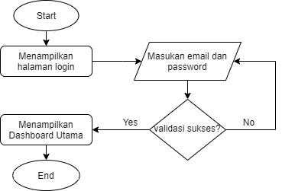
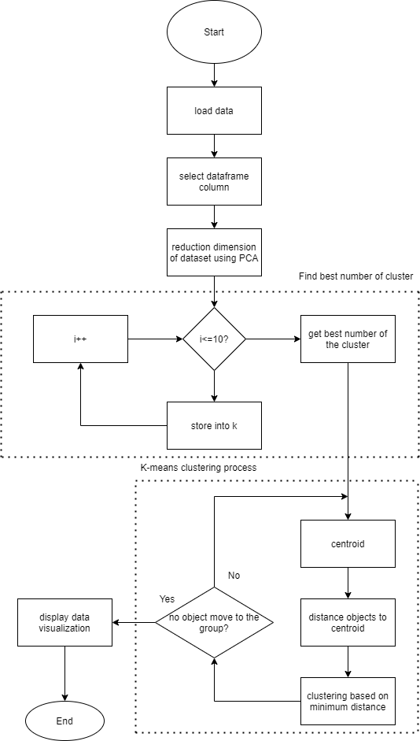
Flowchart process
Flowchart process
Flowchart system

Slide 8
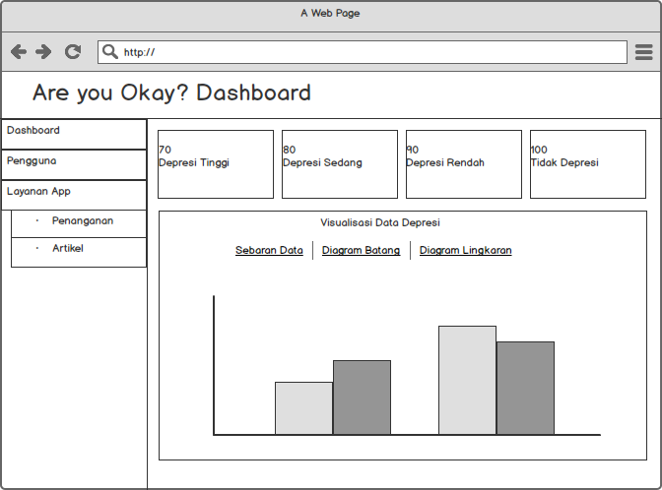
Prototype dashboard page

Slide 9
03
Realization

Slide 10

Technology used

Slide 11
Data used
The data used are 20 user depression data with attributes of age, gender, work status and level of depression.

Slide 12
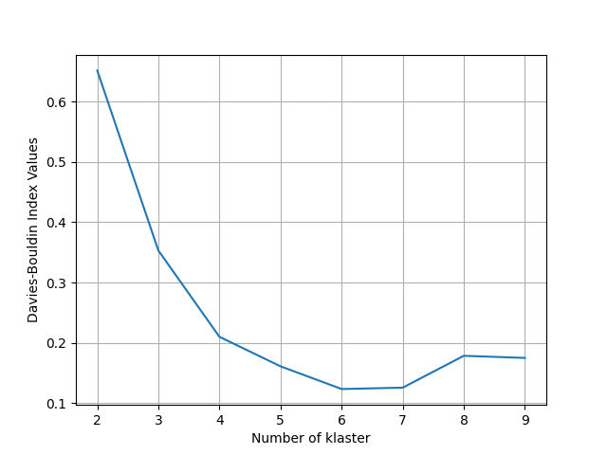
Optimal number of clusters use davies bouldin index

Slide 13
K-Means clustering result
Umur | Jenis Kelamin | Status Pekerjaan | Tingkat Depresi | Klaster | Jumlah Data | Level
22 | Perempuan | Tidak Kerja | Depresi Berat | 4 | 1 | 4
17 | Perempuan | Pelajar/Mahasiswa | Depresi Sedang | 0 | 1 | 3
18 | Laki-laki | Pelajar/Mahasiswa | Depresi Sedang | 3 | 1
22 | Perempuan | Pelajar/Mahasiswa | Depresi Sedang | 0 | 1
22 | Laki-laki | Pelajar/Mahasiswa | Depresi Sedang | 3 | 1
25 | Perempuan | Kerja | Depresi Sedang | 0 | 1
19 | Laki-laki | Pelajar/Mahasiswa | Depresi Sedang | 3 | 1
18 | Perempuan | Pelajar/Mahasiswa | Depresi Sedang | 0 | 1
21 | Laki-laki | Pelajar/Mahasiswa dan Kerja | Depresi Ringan | 5 | 1 | 2
21 | Laki-laki | Pelajar/Mahasiswa dan Kerja | Tidak Depresi | 1 | 1 | 1
19 | Perempuan | Pelajar/Mahasiswa | Tidak Depresi | 2 | 2
22 | Laki-laki | Pelajar/Mahasiswa | Tidak Depresi | 1 | 1
22 | Laki-laki | Pelajar/Mahasiswa dan Kerja | Tidak Depresi | 1 | 2
22 | Perempuan | Pelajar/Mahasiswa | Tidak Depresi | 2 | 1
18 | Perempuan | Pelajar/Mahasiswa | Tidak Depresi | 2 | 2
23 | Laki-laki | Pelajar/Mahasiswa dan Kerja | Tidak Depresi | 1 | 1
21 | Perempuan | Pelajar/Mahasiswa dan Kerja | Tidak Depresi | 2 | 1

Slide 14
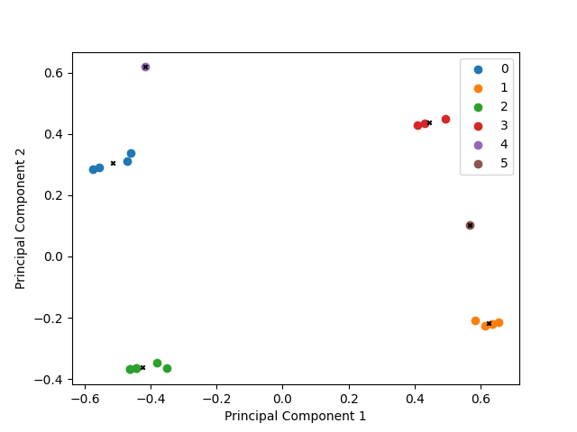
K-Means clustering visualization

Slide 15
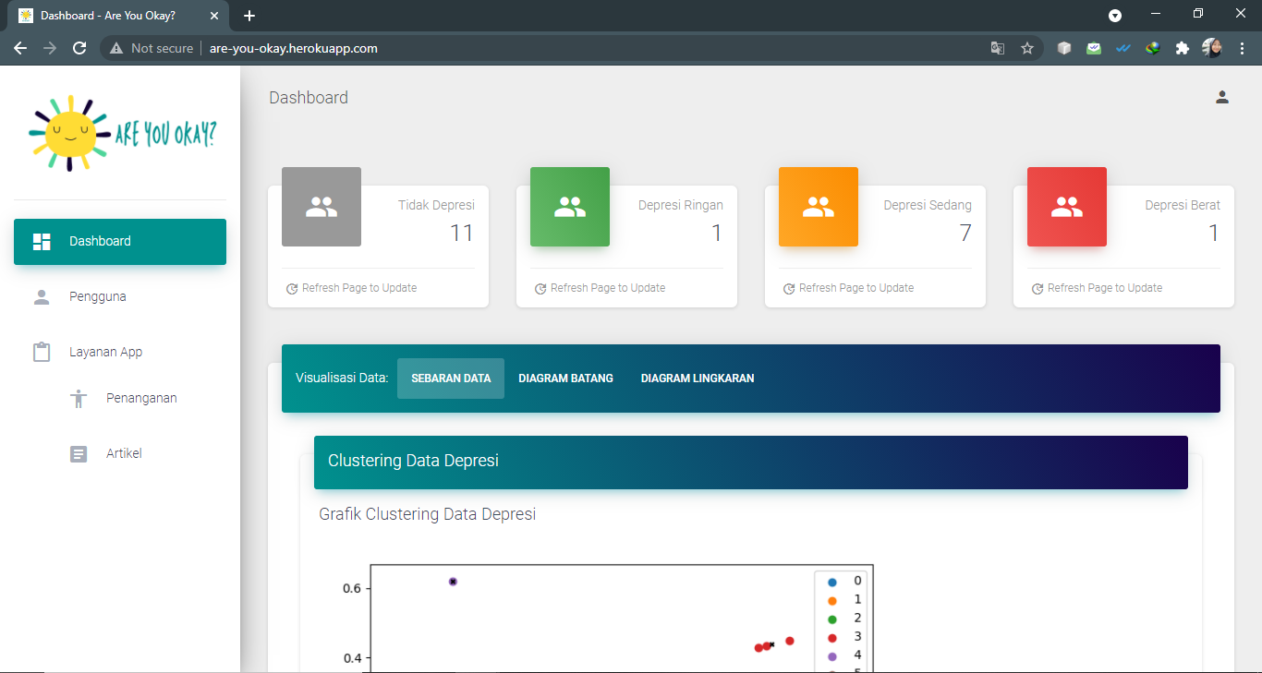
Website result

Slide 16
Conclusions and suggestions
04

Slide 17
Conclusions
Implementation of the K-Means clustering method in grouping data based on age, gender, work status and level of depression was successfully carried out with the results of 6 clusters from the range 0-5 based on the davies bouldin index test and can be visualized on the website

Slide 18
Suggestions
Adding graphical visualization for the distribution of clustered data that is more understandable for users for each feature that is clustered

Slide 19
any question?

Slide 20
Thanks

